Slide 1
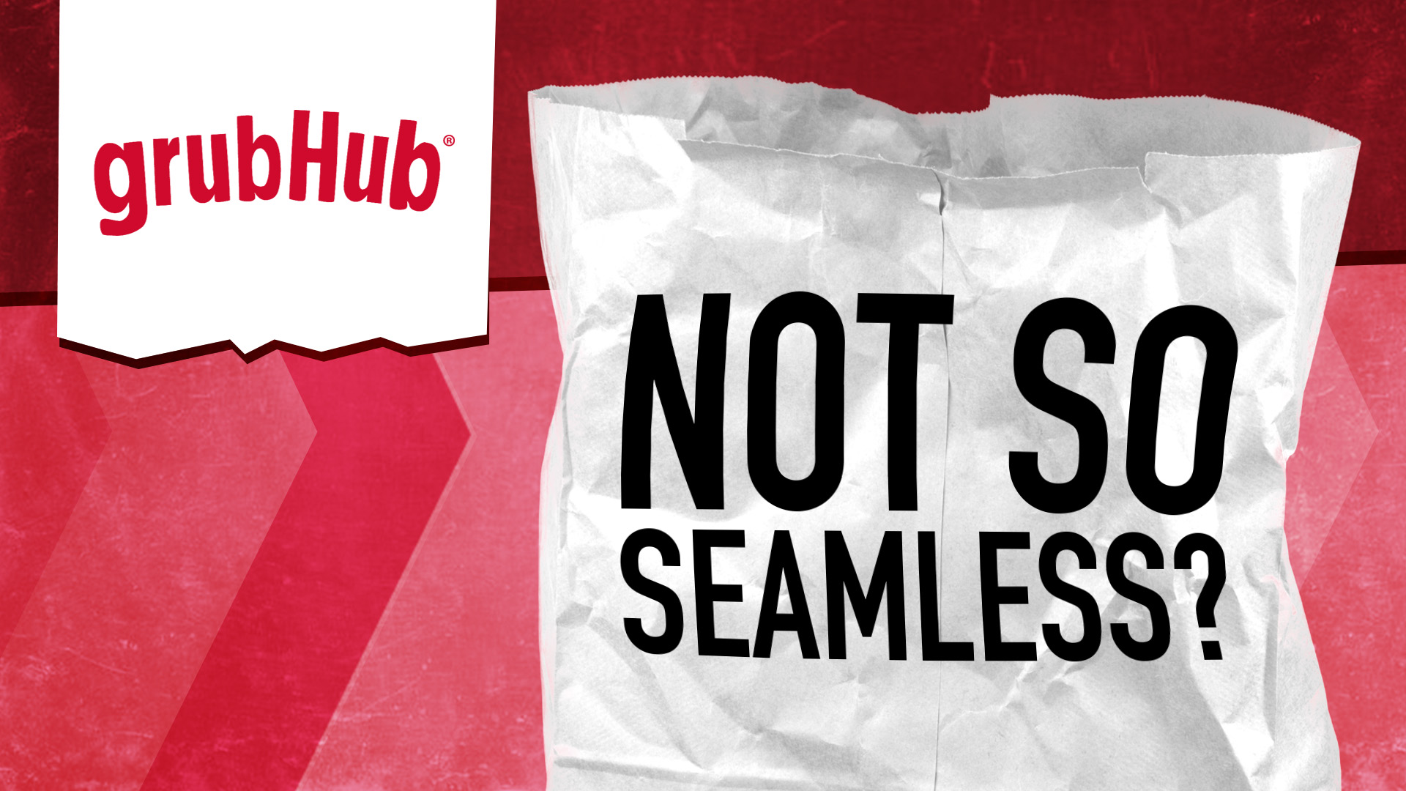
A dive into the famous globally leading ‘GrubHub’ food delivery app

Slide 2
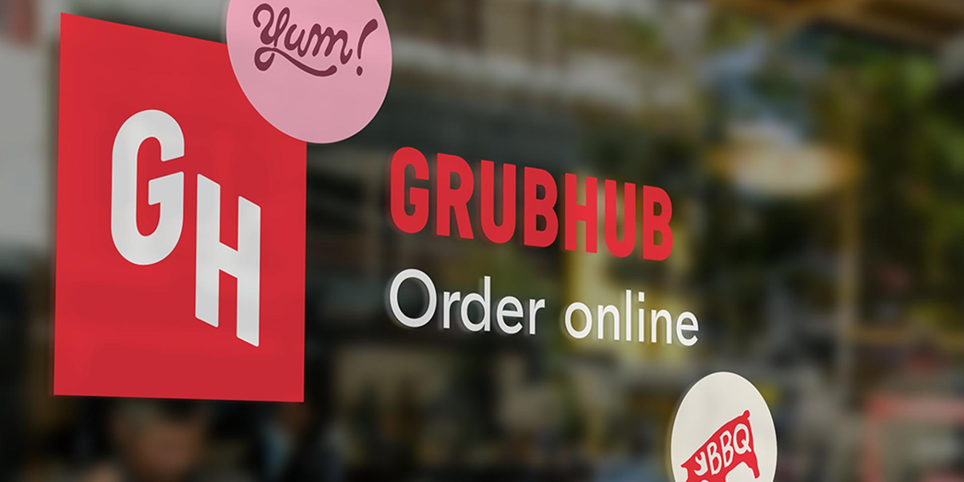
A Bit About The App
Grubhub is part of Just Eat Takeaway.com. A leading global online food delivery marketplace. Dedicated to connecting more than 33 million diners with the food they love from their favorite local restaurants, Grubhub elevates food ordering through innovative restaurant technology, easy-to-use platforms and an improved delivery experience. Grubhub features more than 300,000 restaurant partners in over 4,000 U.S. cities.
Company Statistics
Provided nearly $9 billion in gross food sales to local takeout restaurants in 2020
Processes more than 745,000 daily orders
Serves 33 million active diners
Sent more than $4 billion in total tips to drivers to date

Slide 3
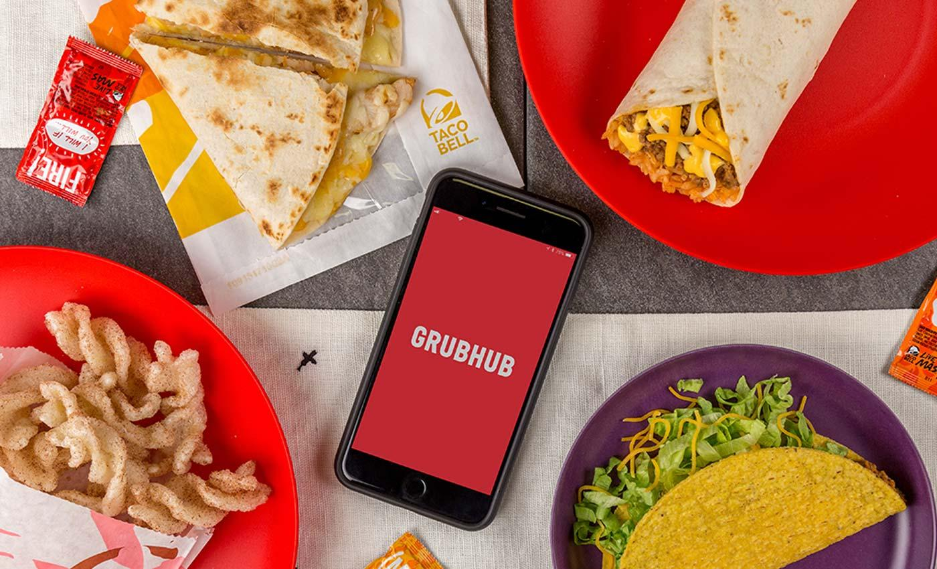
Challenges
GrubHub, in recent years, have faced challenge due to the rising competition from leading companies, such as Amazon, surprisingly enough. Te newest arrival to the on-demand delivery market may pose a serious threat to Grubhub Inc.'s success moving forward. Amazon launched its own meal delivery service Amazon Restaurants last November, and the company has been rapidly expanding the service across the US.
It is now available in 10 US cities exclusively to members of Amazon's Prime subscription program. This may seem like a miniscule base — Grubhub and Seamless are offered in over 1000 cities — but Amazon's business model has the potential to convert users. Unlike veteran delivery services, Amazon has promised not to charge a delivery fee, which will probably give it a real edge with consumers. As Amazon Restaurants arrives in new cities, it could pose a threat not only to Grubhub Inc., but to all of the players in the on-demand meal delivery space.
And within that space, quick-service restaurants (QSRs) — also known as fast-casual restaurants — such as Starbucks have been turning to mobile order-ahead apps to extract higher sales, intensify customer loyalty, and heighten foot traffic.

Slide 4
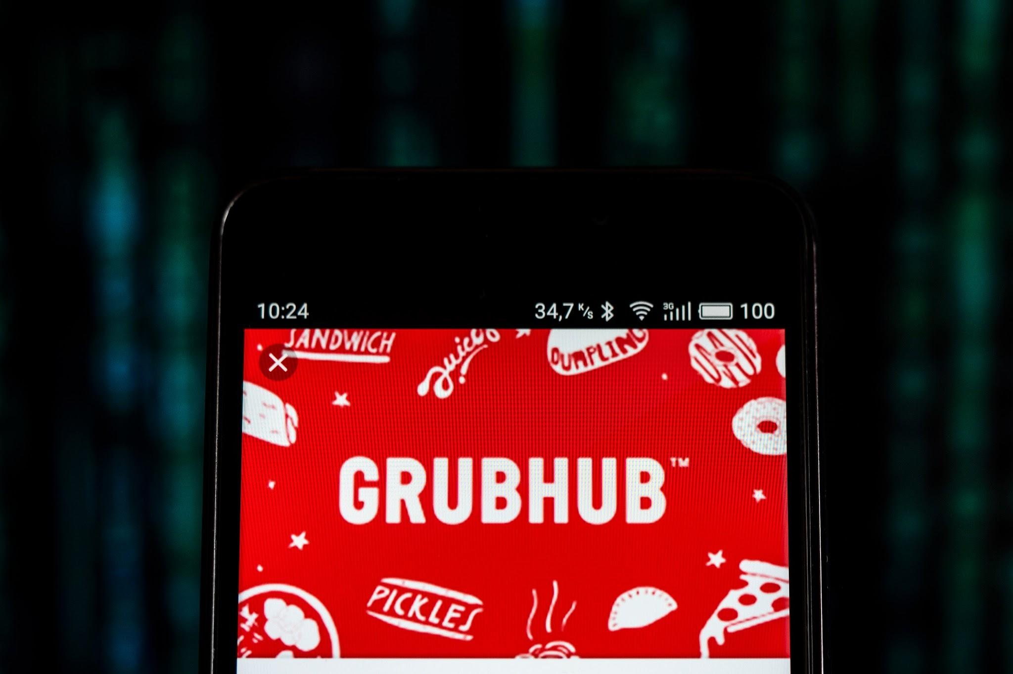
GrubHub - The Features
The original Chicago-based Grubhub was founded in 2004 by Mike Evans and Matt Maloney to create an alternative to paper menus.
The Features
Stay up to speed
Track your order and keep in the know about your delivery with push notifications.
Save your order history
Got a go-to Pad Thai that’s never let you down? You can find previous meals quickly with your order history, and reorder favorites in as little as two taps with Express Reorder.
Plan ahead with preorder
Place your order from two hours to four days in advance for food delivered right when you know you’ll need it.
Pay how you want
We accept Apple Pay, Android Pay, PayPal, eGift and credit cards, or good old-fashioned cash. What works best for you, works great for us.

Slide 5
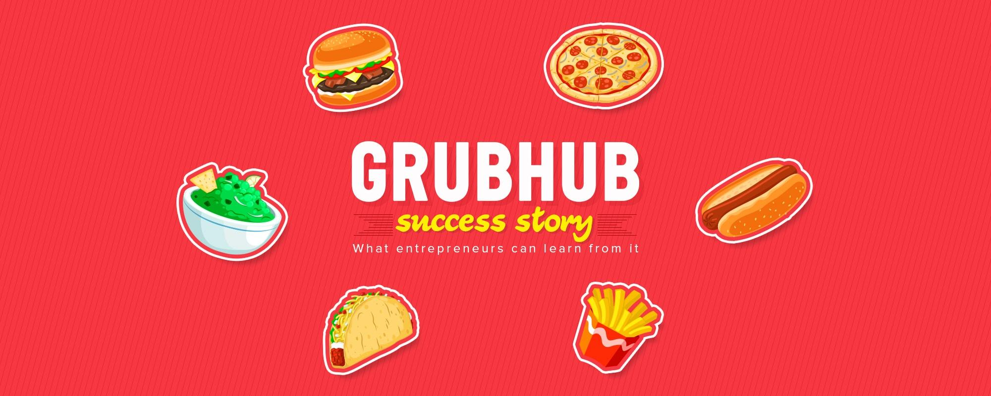
GrubHub’s Objectives - Value Propositions
For Customers:
Helps customers save time and money as they can order food online.
Customers can track the delivery after placing an order
24*7 Customer Service
Users have an option to choose a restaurant from where they want to order.
For Restaurants:
GrubHub has its own delivery persons.
GrubHub provides restaurants with an extended customer base.
GrubHub provides restaurants a software to manage their deliveries through GrubHub in an efficient way.

Slide 6
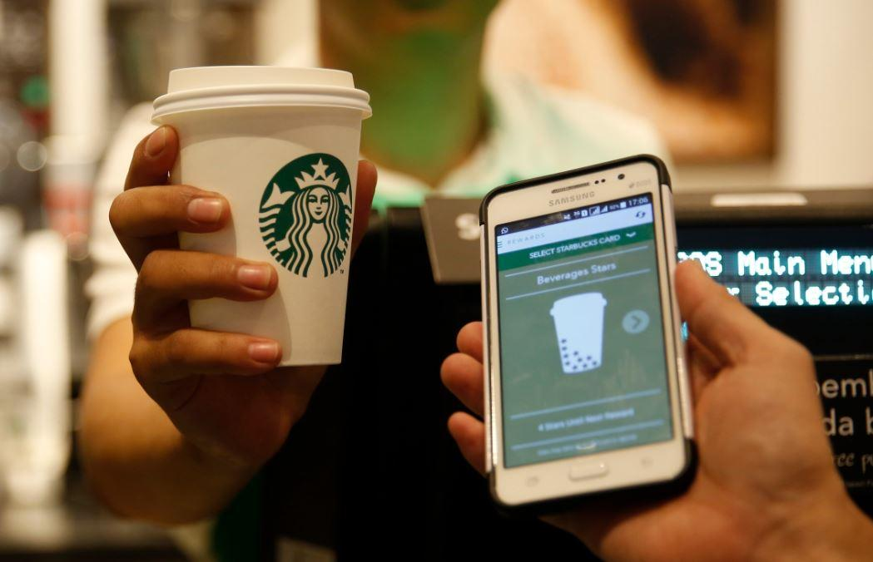
StarBucks App
A synopsis of the food app, from one of the leading coffee restaurants in the world

Slide 7
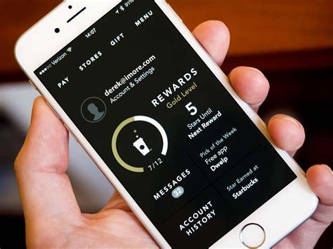
A Bit About The App
Their story began in 1971. Back then they were a roaster and retailer of whole bean and ground coffee, tea and spices with a single store in Seattle’s Pike Place Market. Today, Starbucks is privileged to connect with millions of customers every day with exceptional products and more than 30,000 retail stores in 83 markets. To say Starbucks purchases and roasts high-quality whole bean coffees is very true

Slide 8
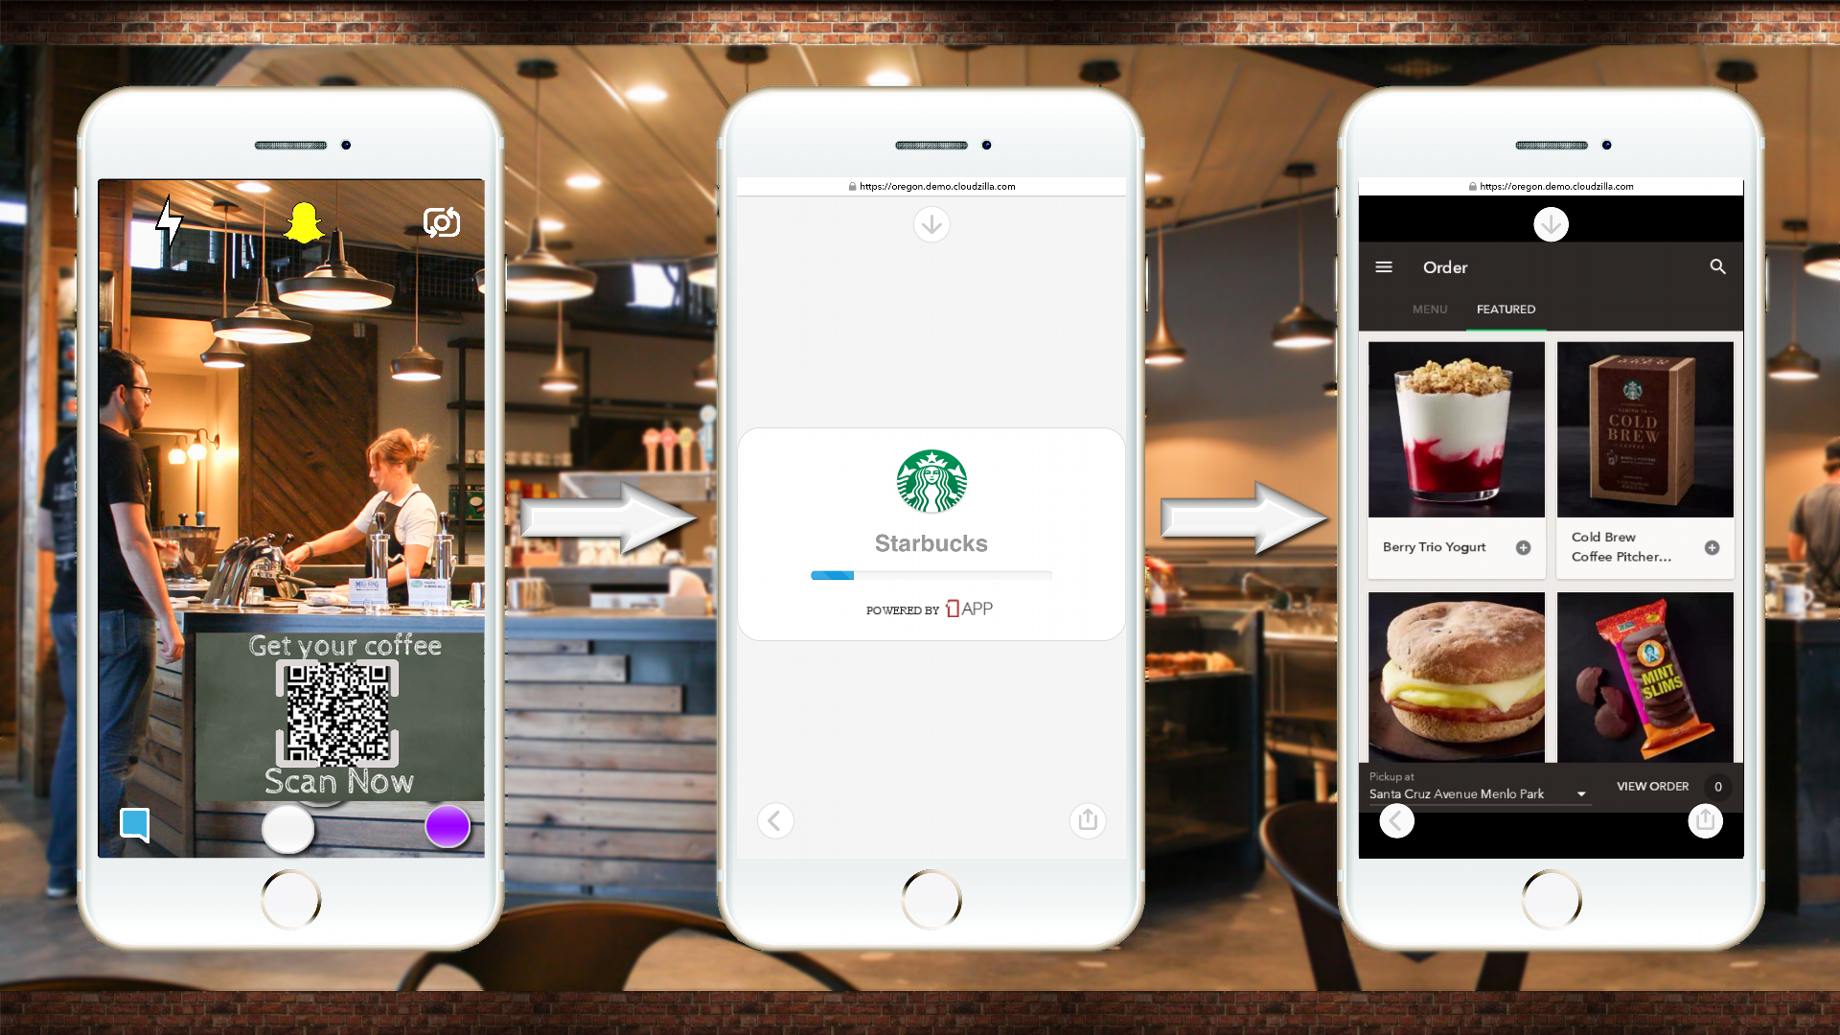
Challenges
The major challenge that Starbucks is dealing with is the current financial crisis in the world economy forcing them to call closures of many stores around the world.
Another challenge that Starbucks is dealing with is competitors. There are numerous coffee shops all over the world and being able to stand out to generate customers is important. Their main competitors are Dunkin Donuts, McDonald’s, and Nestle in the US and brands like Costa Coffee and Caffè Nero in the UK, the two major markets for Starbucks. It is important that for Starbucks to know their competitors and what they are currently doing.
Also Starbuck coffees are priced higher than other market competitors because of Starbucks only purchasing the highest quality coffee beans for their product, thus increasing the price of the drink giving the competitors a cost advantage over Starbucks.
Also Starbucks inadequate marketing strategy on advertising is a hindrance in the business growth opportunities. They prefer to build the brand by promoting the drinks cup-by-cup with customers. The advertisement ends until they drink the coffee, reducing the chances to attract valuable customers.

Slide 9
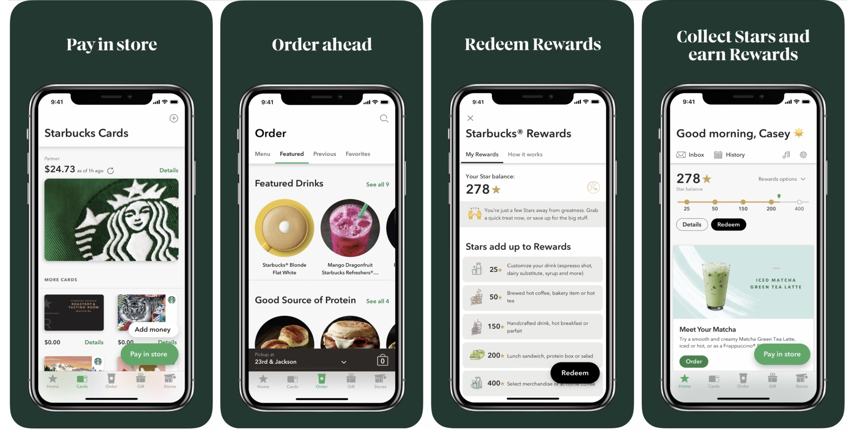
Starbucks App - Features
Download
Starbucks UK from the App store
Join
By setting up an account or log in using the customers existing details
Add money
To the customer’s account
Choose
And customise favourite beverages
Pick up
At selected locations
After acquiring numerous companies and opening countless stores all over the world, its owner expanded his plan to the mobile ecosystem, creating Starbucks app.

Slide 10
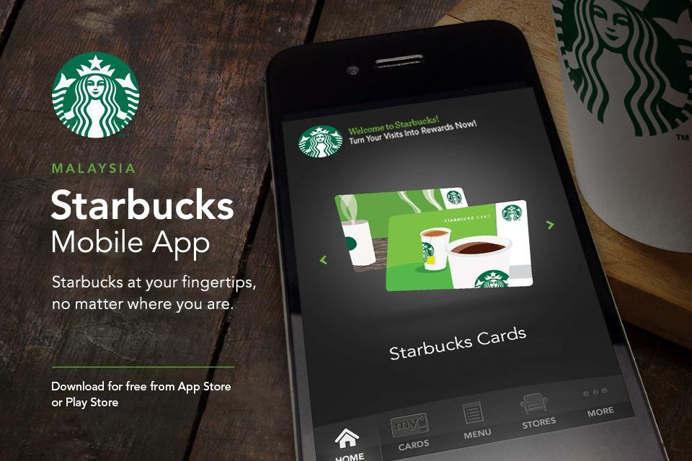
Starbucks App - Objectives
Starbucks' mission is "to inspire and nurture the human spirit – one person, one cup and one neighborhood at a time." The company aims to meet this goal through the development of a culture that embraces acceptance and is supportive of personal growth. As stated in the company's values, personal growth occurs through challenge and grows the company as well. This goal of acceptance extends into the company's diversity and accessibility policies. Company leaders are developed to lead multicultural teams of individuals with diverse perspectives and insights that ensure company growth and improved service delivery for customers. The company seeks to grow relationships with a diverse network of suppliers through strategic community relationship-building.
Starbucks also strives to be open and genuine in its interactions with suppliers, employees and customers. This is reflected in the company mission to drive performance without sacrificing individual and corporate humanity. The company practices this value through its community-building policies, which spur area development through investment. Starbucks values delivering the very best service and accepting responsibility when expectations are not met.

